Slide 1


Continuous Integration (CI) Fundamentals and Pipeline Setup
| DevOps and Cloud Computing

Slide 2

Objective
Understand the importance and benefits of Continuous Integration.
Learn about different CI tools and their advantages.
Set up a basic CI pipeline for automated builds and tests.
Gain hands-on experience configuring and running a simple CI workflow.

Slide 3
Explain what Continuous Integration is and why it is crucial in software development

Slide 4
Continuous Integration (CI)
Continuous Integration (CI) is a software development practice where developers regularly merge their code changes into a central repository. This process involves automated builds and tests to ensure the integrity of the codebase.
CI is a key component of DevOps practices, aiming to streamline the software development lifecycle by providing rapid feedback on code changes
Key Components of CI:
Frequent Integration
Automated Builds
Automated Testing
Version Control Systems

Slide 5
Continuous Integration (CI)
Why is Continuous Integration Crucial in Software Development?
Reduces Risk and Increases Quality
Enhances Collaboration and Transparency
Speeds Up Development and Deployment
Supports Agile Development

Slide 6
Pop Quiz
Q. What is typically involved in the Continuous Integration process?
A
Only version control without testing.
B
Automated builds and tests triggered by code commits.

Slide 7
Pop Quiz
Q. What is typically involved in the Continuous Integration process?
A
Only version control without testing.
B
Automated builds and tests triggered by code commits.

Slide 8
Benefits of CI

Slide 9
Benefits of CI
Here are the key benefits of Continuous Integration:
Early Bug Detection: Identifies issues early in the development cycle, reducing downstream problems.
Faster Feedback Loops: Provides immediate feedback on code changes, enhancing developer productivity.
Improved Collaboration and Code Quality: Enhances teamwork and ensures a stable, reliable codebase through regular integration and testing.

Slide 10
Discuss popular CI tools

Slide 11
Popular CI tools
Jenkins:
Open-source: Free to use and modify.
Highly Customizable: Supports a wide range of plugins for various tasks and integrations.
Self-hosted: Can be run on-premises or in the cloud.
Travis CI:
Cloud-based: Hosted solution, reducing infrastructure management.
GitHub Integration: Seamlessly integrates with GitHub repositories, making it a popular choice for open-source projects.
Multi-language Support: Supports a variety of programming languages.

Slide 12
Popular CI tools
CircleCI:
Docker and Kubernetes Support: Optimized for containerized environments.
Speed and Efficiency: Designed for fast build and deployment cycles.
Cloud-based: Offers scalability and reliability in cloud environments.

Slide 13
Pop Quiz
Q. Which CI tool is known for its tight integration with GitHub?
A
Travis CI
B
CircleCI

Slide 14
Pop Quiz
Q. Which CI tool is known for its tight integration with GitHub?
A
Travis CI
B
CircleCI

Slide 15
Compare features, ease of use, and typical use cases

Slide 16
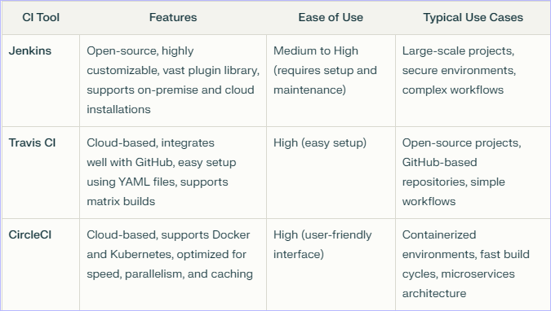
Let’s compare

Slide 17


Take A 5-Minute Break!
Stretch and relax
Hydrate
Clear your mind
Be back in 5 minutes

Slide 18
Explain the CI pipeline stages

Slide 19
CI Pipeline stages
Build:
Purpose: Compile the code and check for syntax errors.
Process: This stage involves taking the source code from a version control system and converting it into an executable format. It ensures that the code can be compiled without errors.
Test:
Purpose: Run unit tests to validate functionality.
Process: Automated tests are executed to verify that the code behaves as expected. This includes unit tests, integration tests, and sometimes UI tests.

Slide 20
CI Pipeline stages
Deploy (Optional):
Purpose: Automate deployment in later CI/CD stages.
Process: While deployment is typically part of the Continuous Deployment (CD) phase, some CI pipelines may include automated deployment to staging or production environments if the tests pass. However, in a strict CI context, deployment is not always included.

Slide 21
Pop Quiz
Q. What is the sequence of stages in a typical CI pipeline??
A
Build, Test, Deploy
B
Deploy, Build, Test

Slide 22
Pop Quiz
Q. What is the sequence of stages in a typical CI pipeline??
A
Build, Test, Deploy
B
Deploy, Build, Test

Slide 23
Demonstrate setting up a simple CI workflow

Slide 24
Let’s do it
Step 1: Create a Repository with a Sample Project
Create a new repository on GitHub.
Add a sample project (e.g., a simple Node.js app) to the repository.
Step 2: Add a Configuration File
Create a new directory named .github/workflows in your repository.
Create a YAML file (e.g., ci.yml) inside this directory.

Slide 25
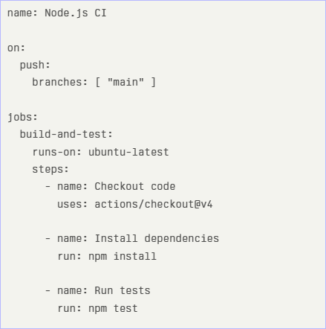
Example ci.yml file for a Node.js project:

Slide 26
Let’s do it
Step 3: Trigger an Automated Build and Test Process
Commit and push the changes to your repository.
Navigate to the "Actions" tab in your repository on GitHub.
View the workflow run to see the automated build and test process.
This setup will trigger a CI workflow every time you push changes to the main branch, automating the build and test process for your project.

Slide 27
Time for case study!

Slide 28
Important
Complete the post-class assessment
Complete assignments (if any)
Practice the concepts and techniques taught in this session
Review your lecture notes
Note down questions and queries regarding this session and consult the teaching assistants

Slide 29
Thanks!

